Slide 1


COMPUTER NETWORKS
24Cs2202
Topic:
ERROR CORRECTION & DECTECTION
Session – 11
Session –11

Slide 2













AIM OF THE SESSION
To familiarize students with the basic idea of Error Control in Data link layer.
INSTRUCTIONAL OBJECTIVES
This Session is designed to:
Describe different types of errors.
Understand different types of error detection methods.
Understand error correction mechanism.
LEARNING OUTCOMES
At the end of this session, you should be able to:
Identify the types of errors.
Apply different error detection techniques to identify the error.
Apply hamming code to detect and correct the error in the data.

Slide 3
Error Detection and Correction
Types of Errors
Detection
Error Correction

Slide 4
ii
INTRODUCTION
Data can be corrupted during transmission.
For reliable communication, error must be detected and corrected.
Error Detection and Correction are implemented either at the data link layer or the transport layer of the OSI model.

Slide 5
Error Correction

Slide 6

Error Correction
Error correction can be handled in two ways
when an error is discovered, the receiver can retransmit the entire data unit.
A receiver can use an error-correcting code, which automatically corrects certain errors.
Hamming Code is a block code that is capable of detecting up to two simultaneous bit errors and correcting single-bit errors. It was developed by R.W. Hamming for error correction.

Slide 7
Hamming Code
Encoding a message by Hamming Code:
The procedure used by the sender to encode the message consists of following steps −
Step 1 − Calculation of the number of redundant bits.
( 2^{r} ≥ m+r+1 )
Step 2 − Positioning the redundant bits.
(r redundant bits placed at bit positions of powers of 2)
Step 3 − Calculating the values of each redundant bit.
(bit positions whose binary representation includes a 1 in the i^{th} position)
Once the redundant bits are embedded within the message, this is sent to the user.

Slide 8
Hamming Code…
Decoding a message in Hamming Code:
Once the receiver gets an incoming message, it performs parity checking.
Parity bits are calculated based upon the data bits and the redundant bits using the same rule as during generation of c1,c2 ,c3 ,c4 etc. Thus
c1 = parity(1, 3, 5, 7, 9, 11 and so on)
c2 = parity(2, 3, 6, 7, 10, 11 and so on)
c3 = parity(4-7, 12-15, 20-23 and so on)
The decimal equivalent of the parity bits binary values is calculated. If it is 0, there is no error. Otherwise, the decimal value gives the bit position which has error.

Slide 9
Error Correction
Error correction can be handled in two ways
when an error is discovered, the receiver can retransmit the entire data unit.
A receiver can use an error-correcting code, which automatically corrects certain errors.

Slide 10
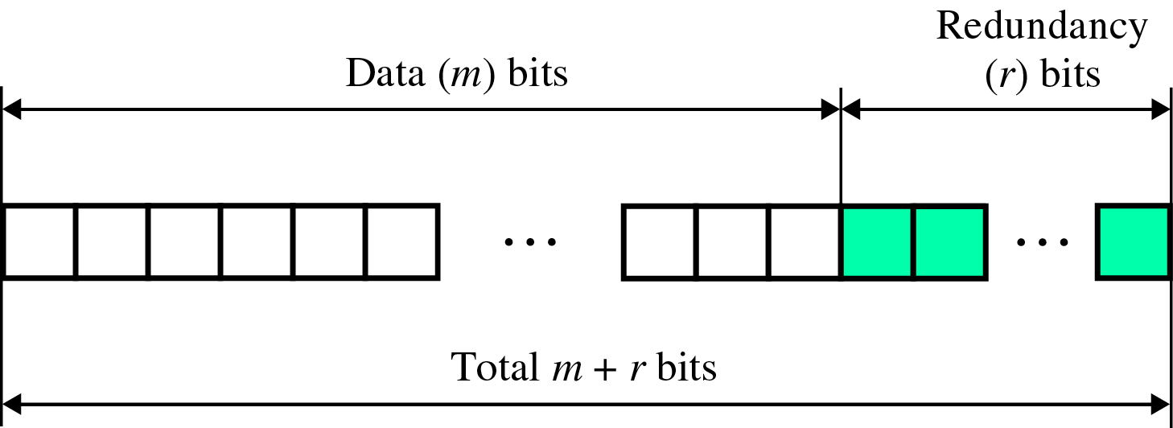
Error Correction(cont’d)
Redundancy Bits
to calculate the number of redundancy bits (R) required to correct a given number of data bit (M)

Slide 11
Error Correction(cont’d)
If the total number of bits in a transmittable unit is m+r, then r must be smallest value that can satisfy the following,
2^{r} ≥ m + r + 1
ex) For value of m is 7(ASCII), the smallest r value that can satisfy this equation is 4
2⁴ ≥ 7 + 4 + 1

Slide 12
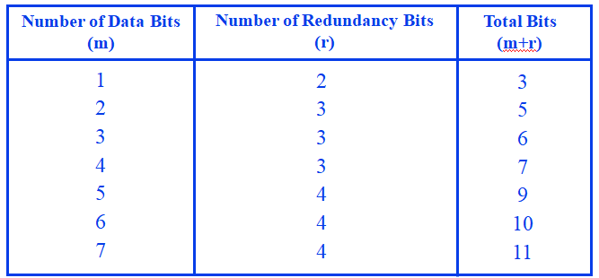
Error Correction(cont’d)
Relationship between data and redundancy bits

Slide 13
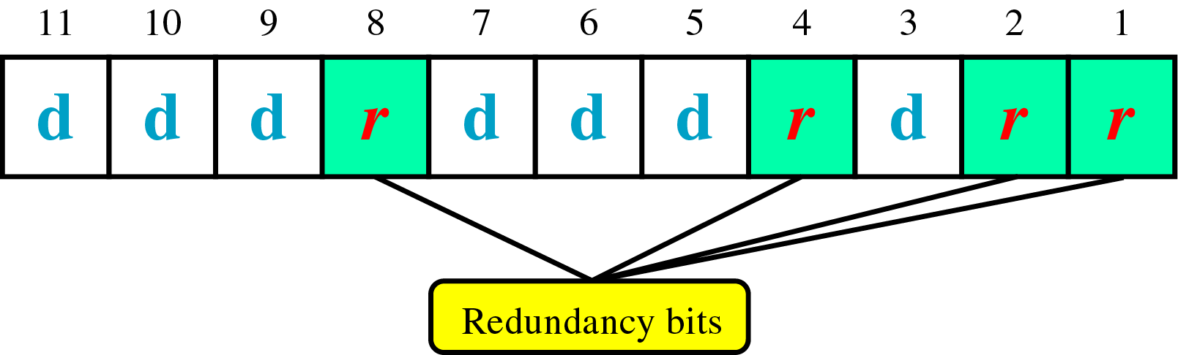
Error Correction(cont’d)
Hamming Code
~ developed by R.W.Hamming
positions of redundancy bits in Hamming code

Slide 14
Error Correction(cont’d)
each r bit is the Vertical Redundancy Check(VRC) bit
  r₁ = bits 1, 3, 5, 7, 9, 11
  r₂ = bits 2, 3, 6, 7, 10, 11
  r₄ = bits 4, 5, 6, 7
  r₈ = bits 8, 9, 10, 11

Slide 15
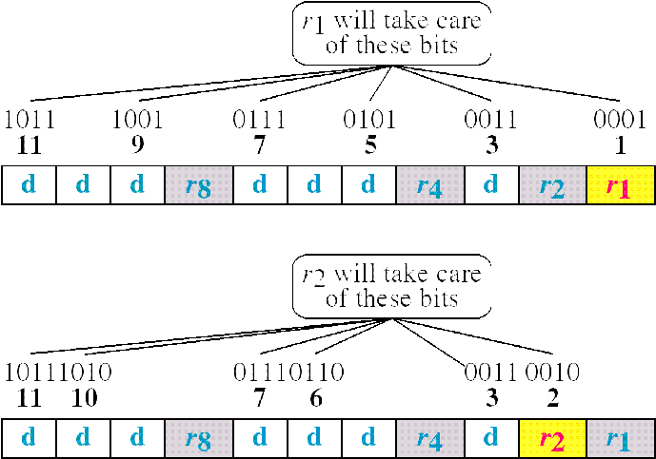
Error Correction(cont’d)
Redundancy bits calculation(cont’d)

Slide 16
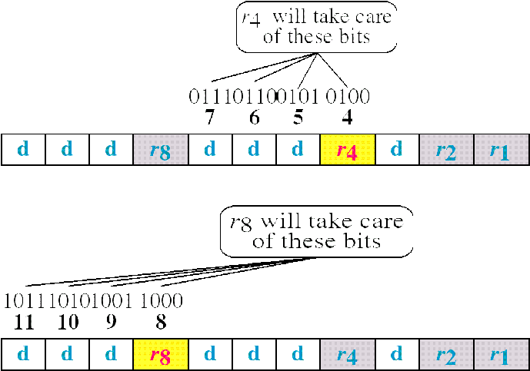
Error Correction(cont’d)
Redundancy bits calculation(cont’d)

Slide 17
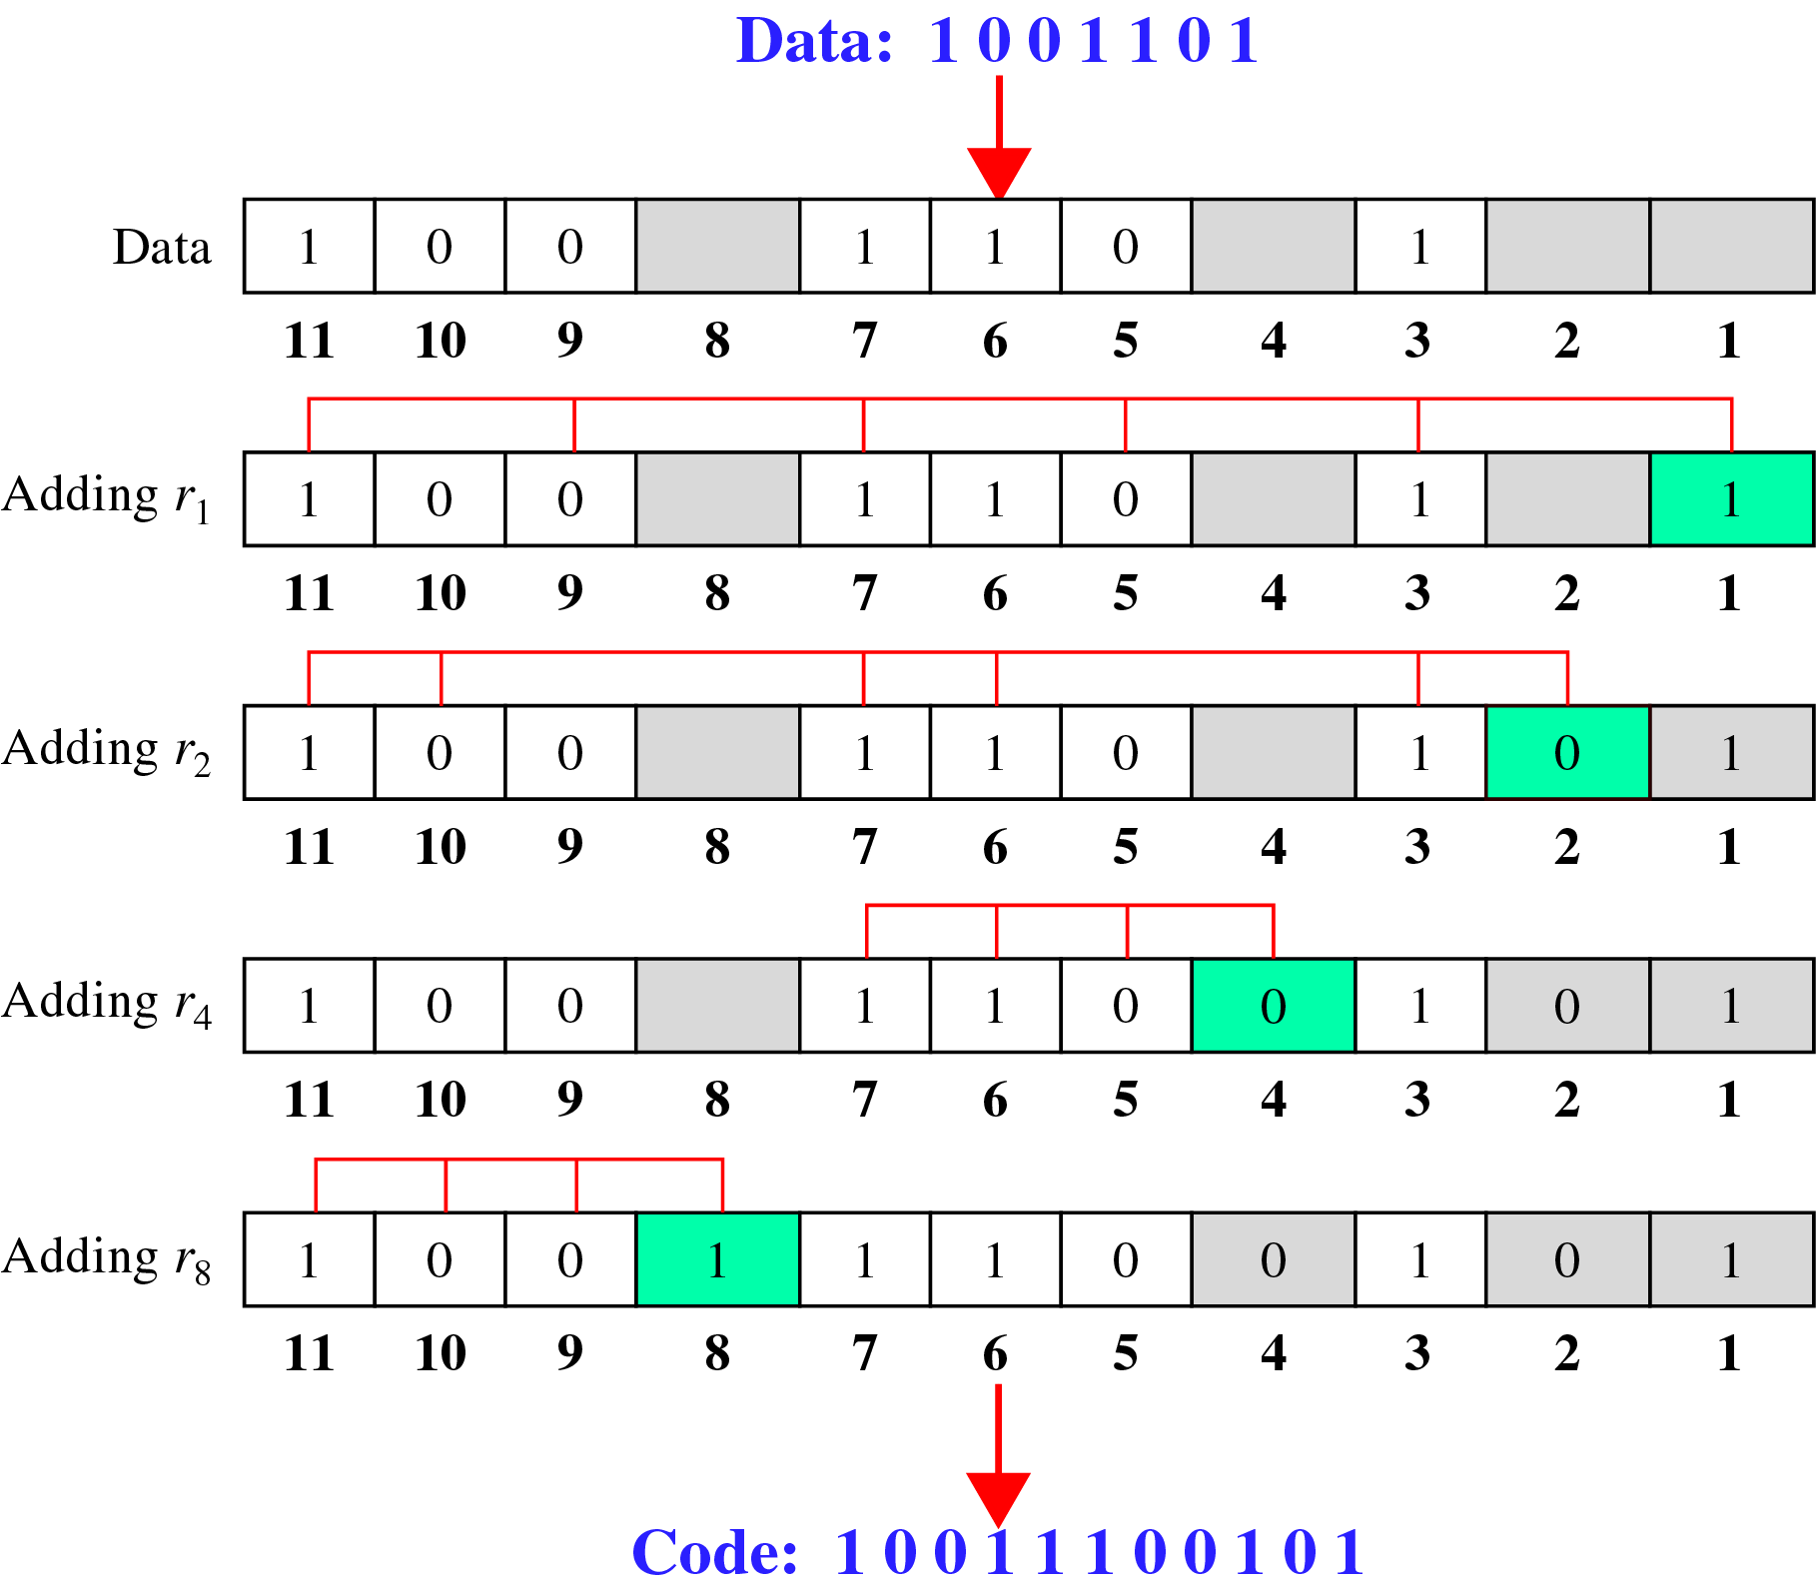
Error Correction(cont’d)
Calculating the r values

Slide 18
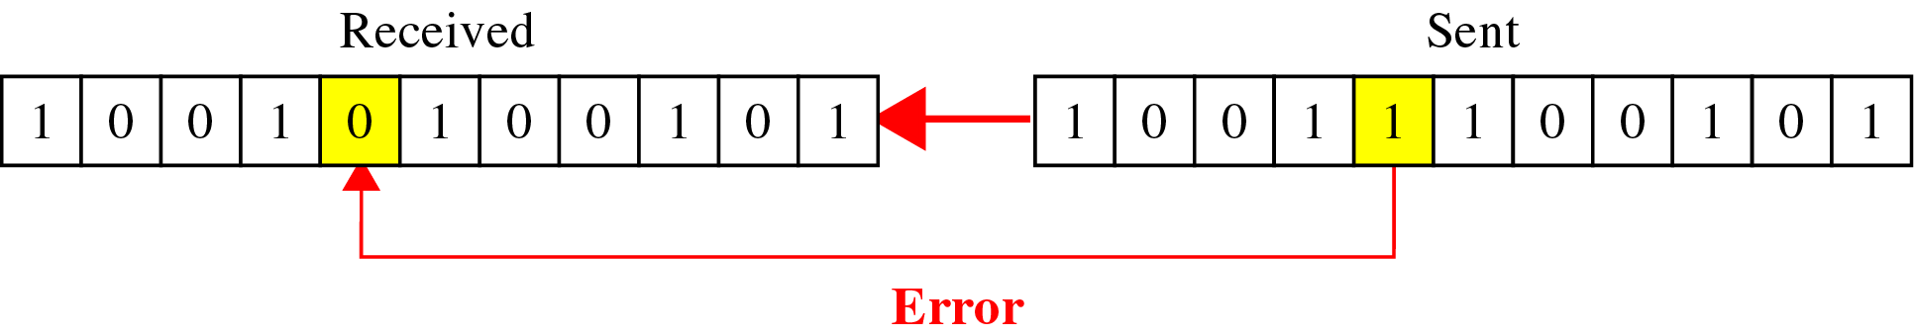
Error Correction(cont’d)
Error Detection and Correction

Slide 19
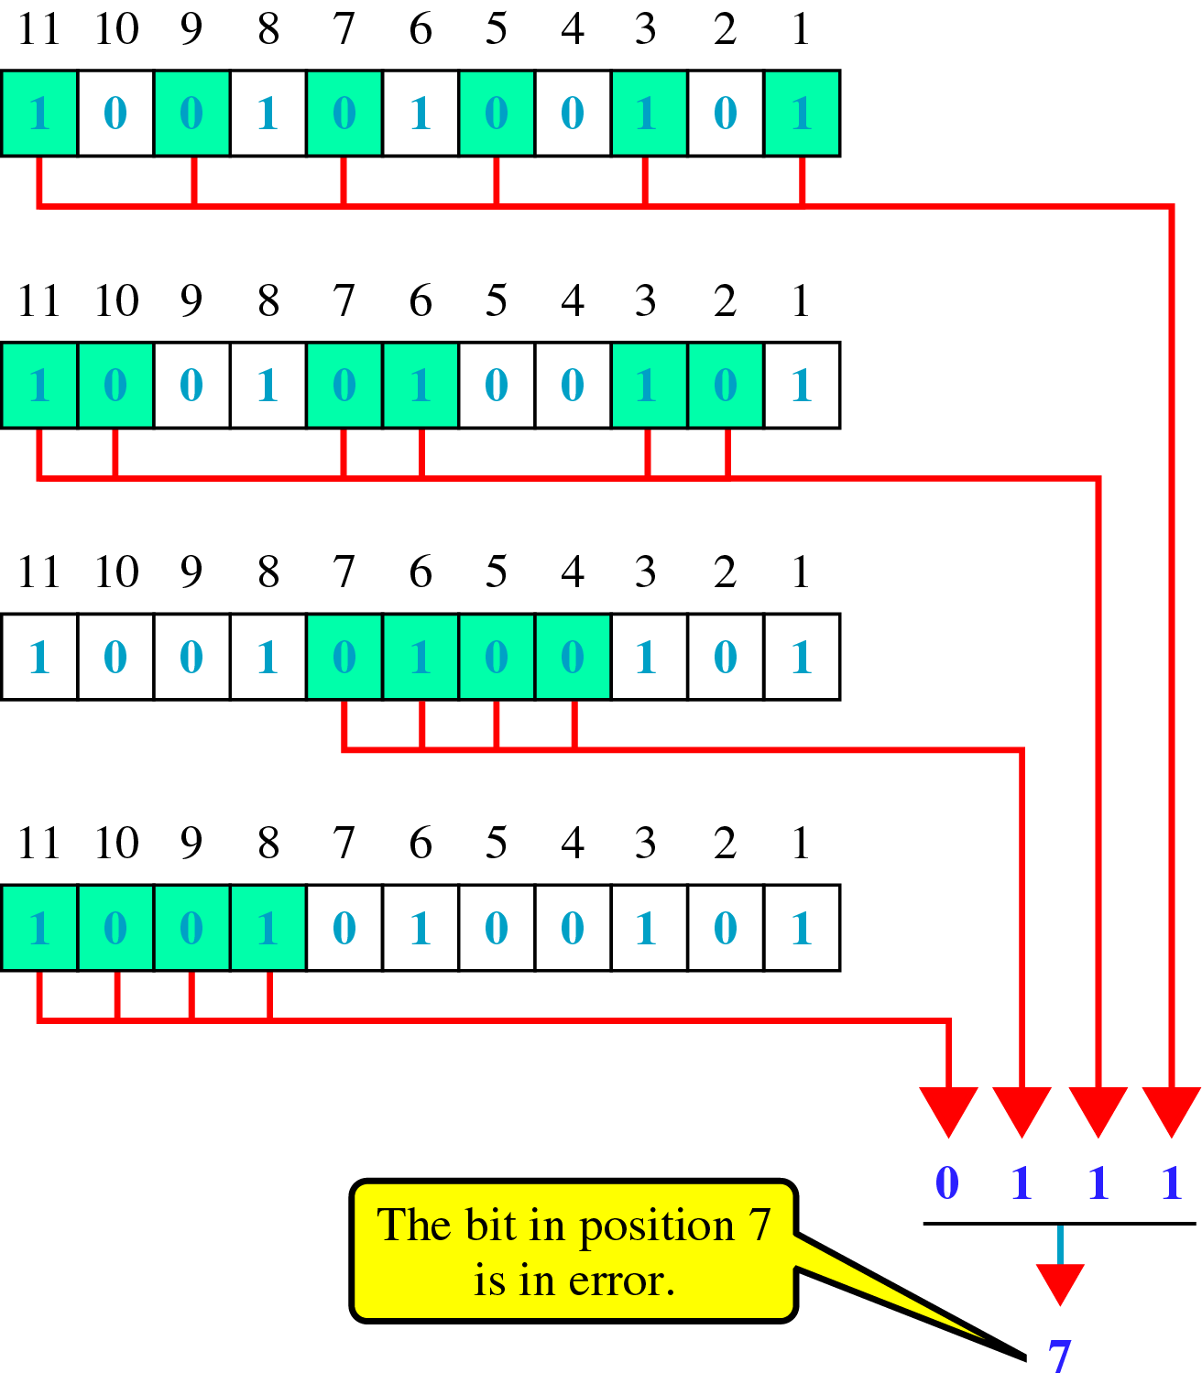
Error Correction(cont’d)
Error detection using Hamming Code

Slide 20
Example-2: perform Hamming code for the data 1011001

Slide 21
Error Correction
Error-correcting codes (ECC) are a sequence of numbers generated by specific algorithms for detecting and removing errors in data that has been transmitted over noisy channels.
Hamming Code is a block code that is capable of detecting up to two simultaneous bit errors and correcting single-bit errors. It was developed by R.W. Hamming for error correction.

Slide 22
Hamming Code
Encoding a message by Hamming Code:
The procedure used by the sender to encode the message encompasses the following steps −
Step 1 − Calculation of the number of redundant bits. ( 2^{r} ≥ m+r+1 )
Step 2 − Positioning the redundant bits.
(r redundant bits placed at bit positions of powers of 2)
Step 3 − Calculating the values of each redundant bit.
(bit positions whose binary representation includes a 1 in the i^{th} position)
Once the redundant bits are embedded within the message, this is sent to the user.

Slide 23
Hamming Code…
Decoding a message in Hamming Code:
Once the receiver gets an incoming message, it performs parity checking.
Parity bits are calculated based upon the data bits and the redundant bits using the same rule as during generation of c1,c2 ,c3 ,c4 etc. Thus
c1 = parity(1, 3, 5, 7, 9, 11 and so on)
c2 = parity(2, 3, 6, 7, 10, 11 and so on) c3 = parity(4-7, 12-15, 20-23 and so on)
The decimal equivalent of the parity bits binary values is calculated. If it is 0, there is no error. Otherwise, the decimal value gives the bit position which has error.
© 2016 KL University – The contents of this presentation are an intellectual and copyrighted property of KL University. ALL RIGHTS RESERVED
35

Slide 24
Hamming Code Example
1. a) Shradha is transmitting data-1101 to her friend. For security reasons, Shradha wishes to send data by implementing the Hamming Code technique so as to make sure of error control. Help Shradha in performing the above (Assume Even parity).
b) Also show the error detection process done by Shradha’s friend for the following cases.
Case1: Received data is correct.
Case2: Second bit from left is changed.

Slide 25
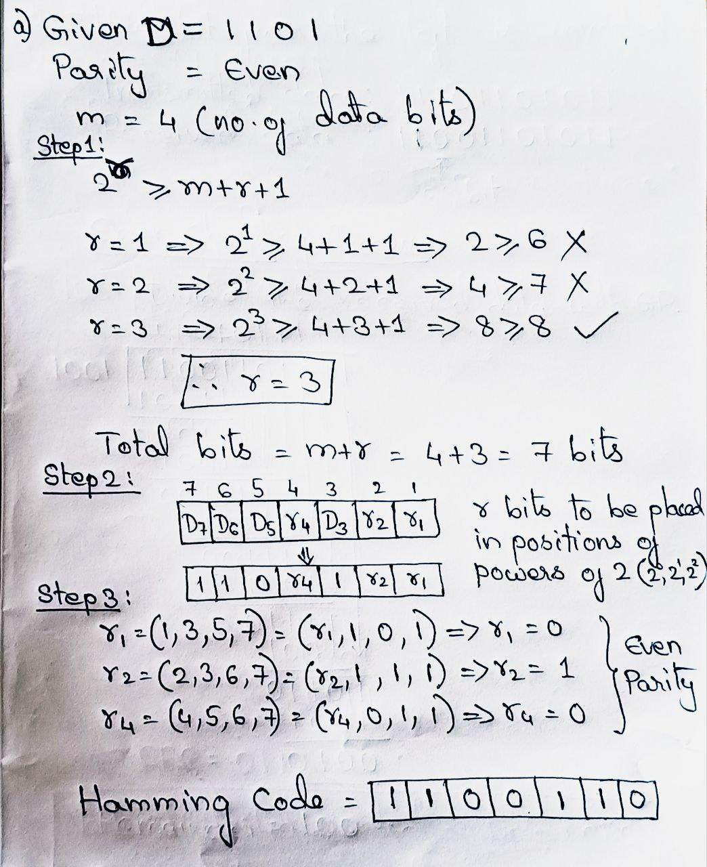
Hamming Code : Solution

Slide 26
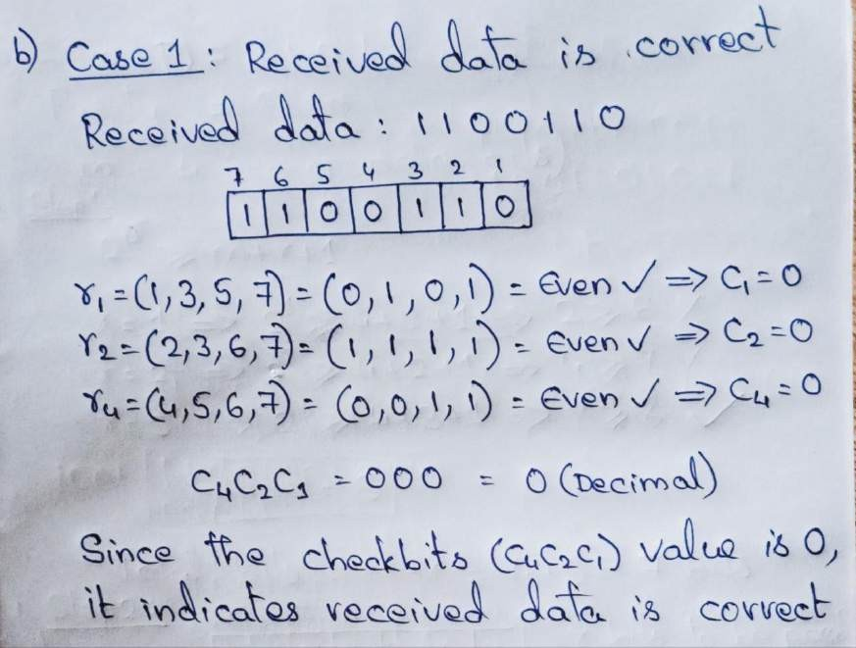
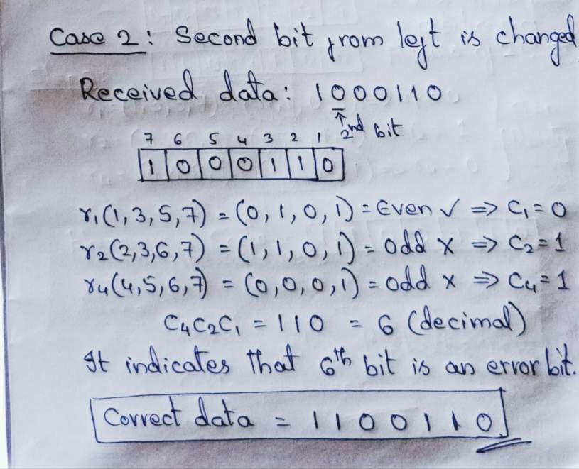
Hamming Code : Solution

Slide 27

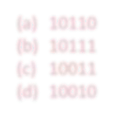


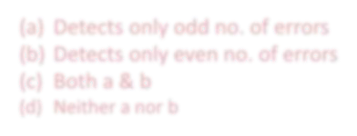


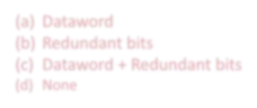


SELF-ASSESSMENT QUESTIONS
1. What is the codeword for the dataword 1011 when even parity is used?
(a) | 10110
(b) | 10111
(c) | 10011
(d) | 10010
2. | What is the drawback of simple parity method?
Detects only odd no. of errors
Detects only even no. of errors
Both a & b
Neither a nor b
3. Codeword means?
(a)
(b)
(c)
(d)
Dataword
Redundant bits
Dataword + Redundant bits
None

Slide 28
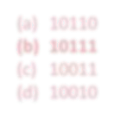
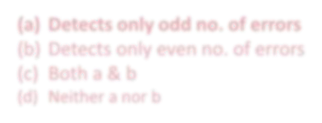
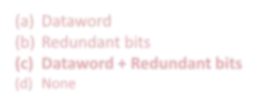
SELF-ASSESSMENT QUESTIONS
1. What is the codeword for the dataword 1011 when even parity is used?
(a) | 10110
(b) | 10111
(c) | 10011
(d) | 10010
2. | What is the drawback of simple parity method?
Detects only odd no. of errors
Detects only even no. of errors
Both a & b
Neither a nor b
3. Codeword means?
(a)
(b)
(c)
(d)
Dataword
Redundant bits
Dataword + Redundant bits
None

Slide 29


SUMMARY
Types of Errors
Error Detection Methods
Error Correction Methods

Slide 30

TERMINAL QUESTIONS
The message 1101011011 is to be transmitted using the generator polynomial x4+x+1 to protect it
from errors. Find the final data to be transmitted after performing CRC.
Original data is 10110011 10101011 01011010 11010101. Perform 2D parity and compute the codeword.
Original data is 10110011 10101011 01011010 11010101. Find out the checksum to detect error.
Similarly, if Shradha is receiving a 7-bit hamming code 1011101, assume Even parity and state whether received data is correct or not. If not locate the error bit?

Slide 31

REFERENCES FOR FURTHER LEARNING OF THE SESSION
Reference Books:
Behrouz A. Forouzan , “Data Communication and Networking”, TMH, 6th Edition ,(2012).
A.S. Tanenbaum, David J. Wetheral “Computer Networks” Pearson, 5th –Edition-(2011).
Sites and Web links:
  https://www.tutorialspoint.com/data_communication_computer_network/error_detection_and_ correction.htm

Slide 32


THANK YOU
Team – COMPUTER NETWORKS

